Slide 1
Trend Bazaar Website
Presentation Presented by:
Monu,Naman,Maqssod,Nishu

Slide 2
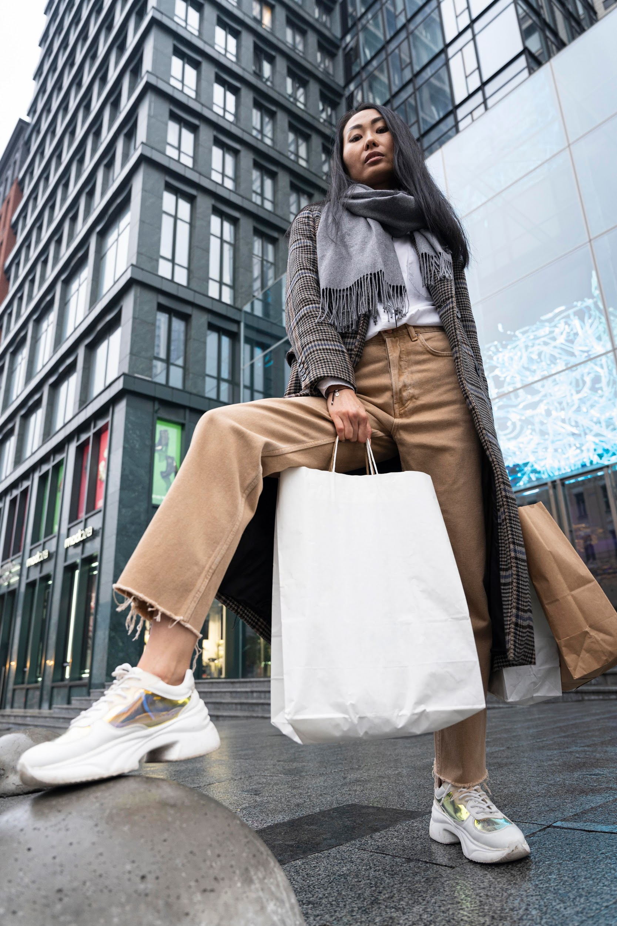
Trend Bazaar
The Trend Bazaar welcomes fashion enthusiasts to an innovation realm where technology and style converge. In a world that’s increasingly connected, we introduce a platform that transforms the way people experience and engage with fashion.

Slide 3

"Unveil Your Style: Trend Bazaar Website - Where every outfit tells your story."

Slide 4
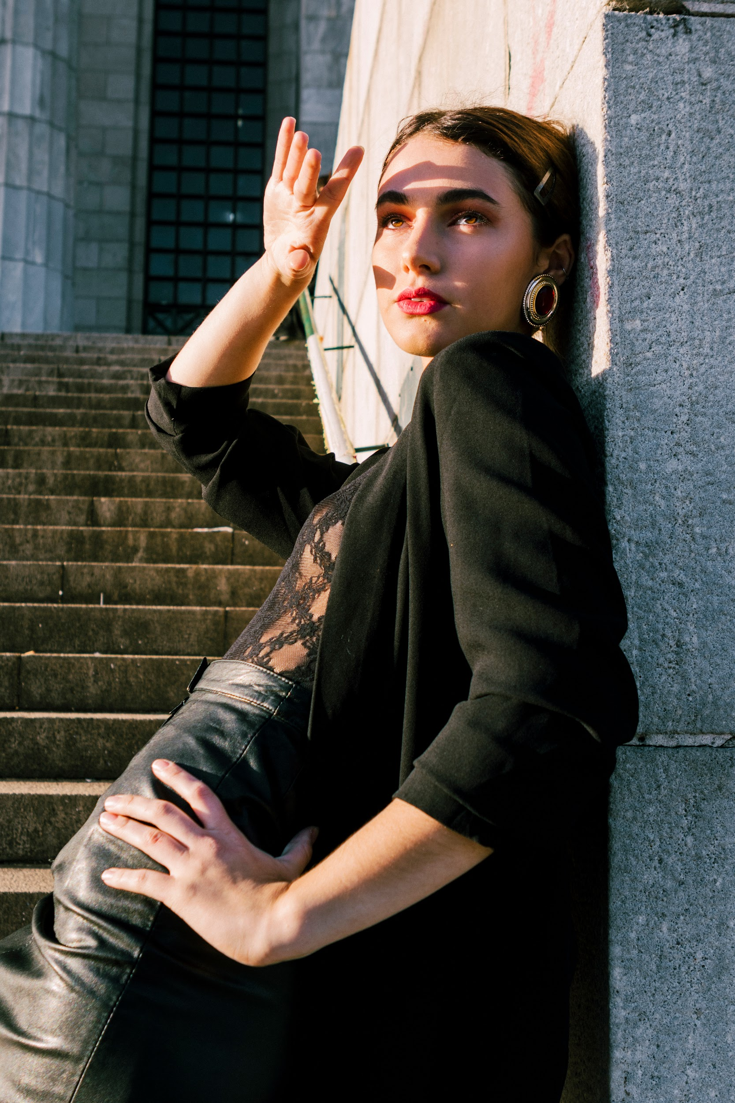
Need Of Website
In an era characterized by rapid technological advancements and changing consumer behaviors, the need for the Trend Bazaar Website has never been more pronounced. This innovative platform addresses the growing demand for convenient and personalized fashion shopping experiences. With the ability to explore a curated selection of clothing items from the comfort of one's home, users can effortlessly navigate the virtual aisles of fashion

Slide 5
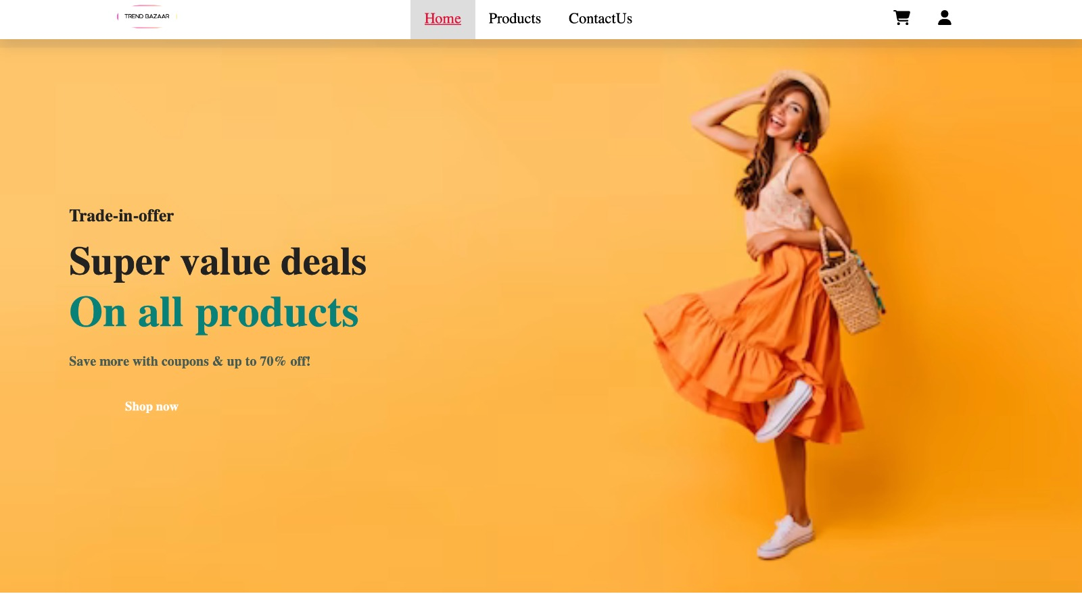
Welcome Page

Slide 6
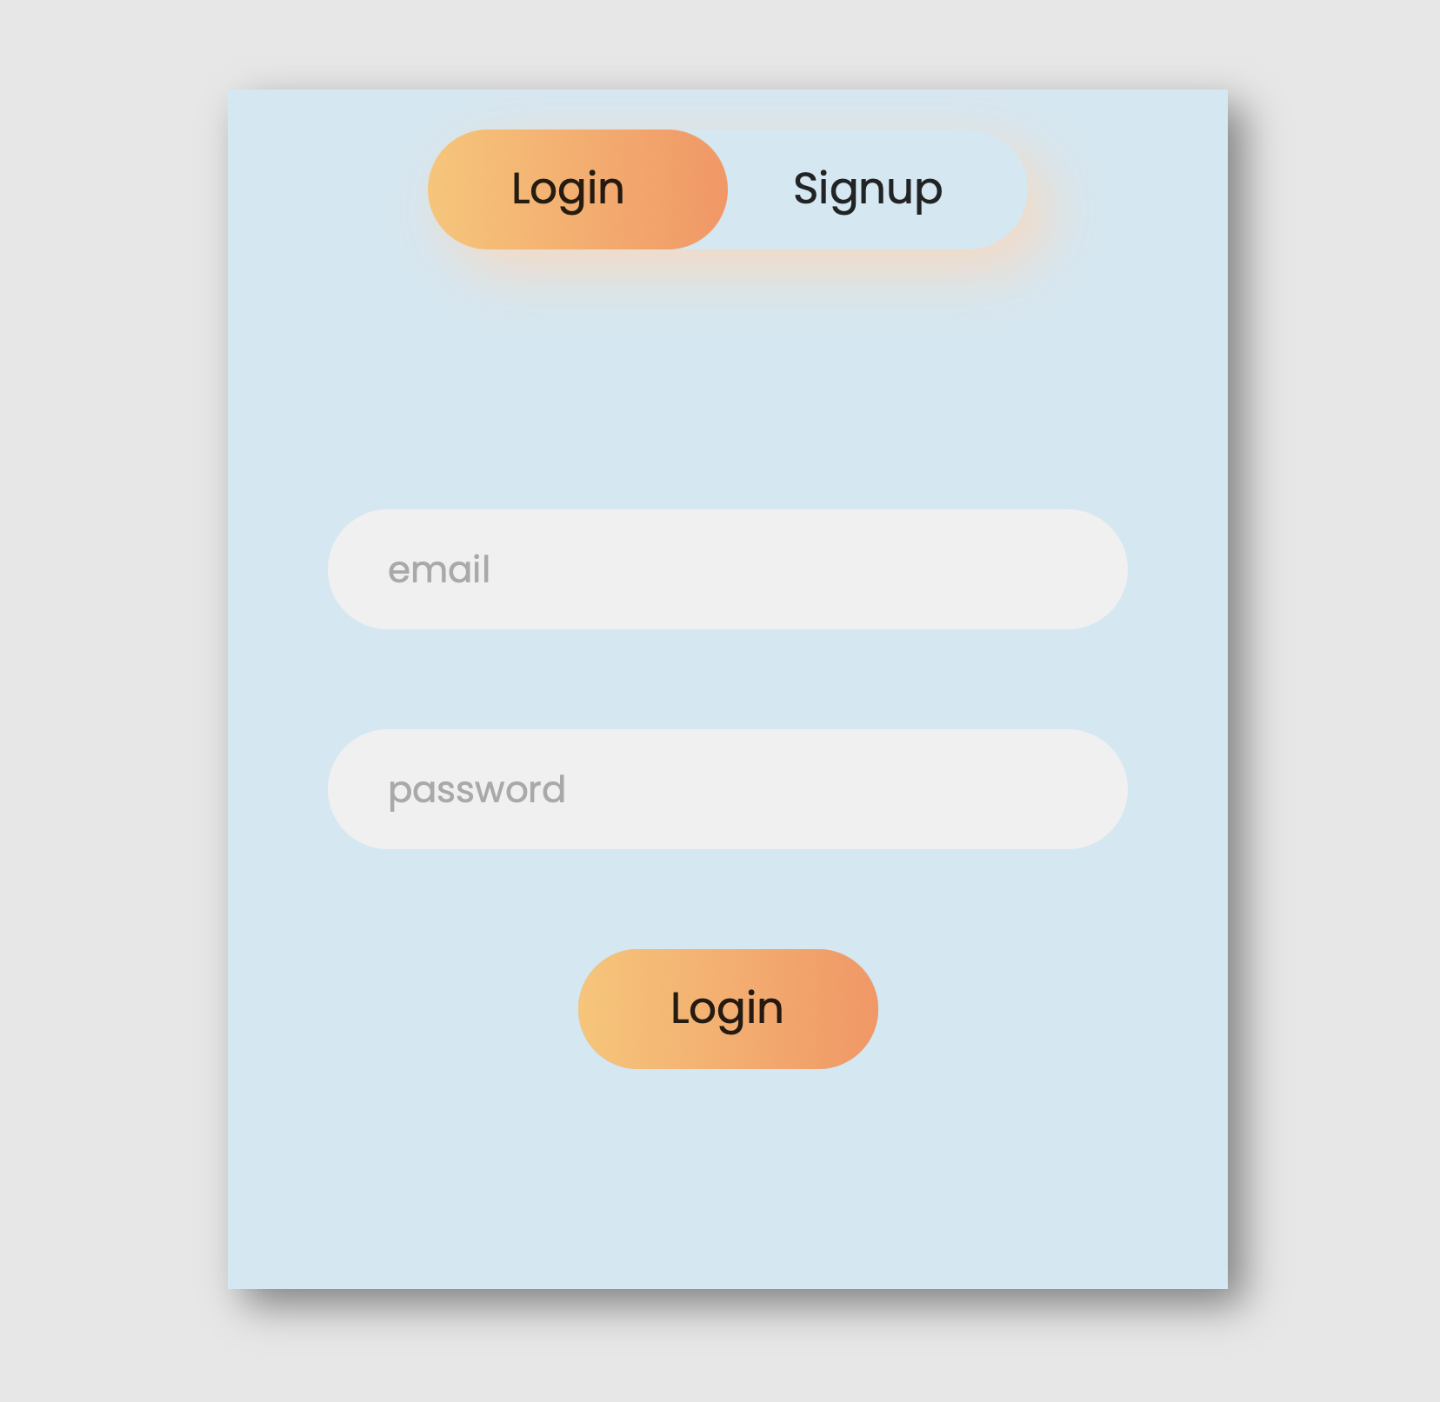
User Login Page

Slide 7
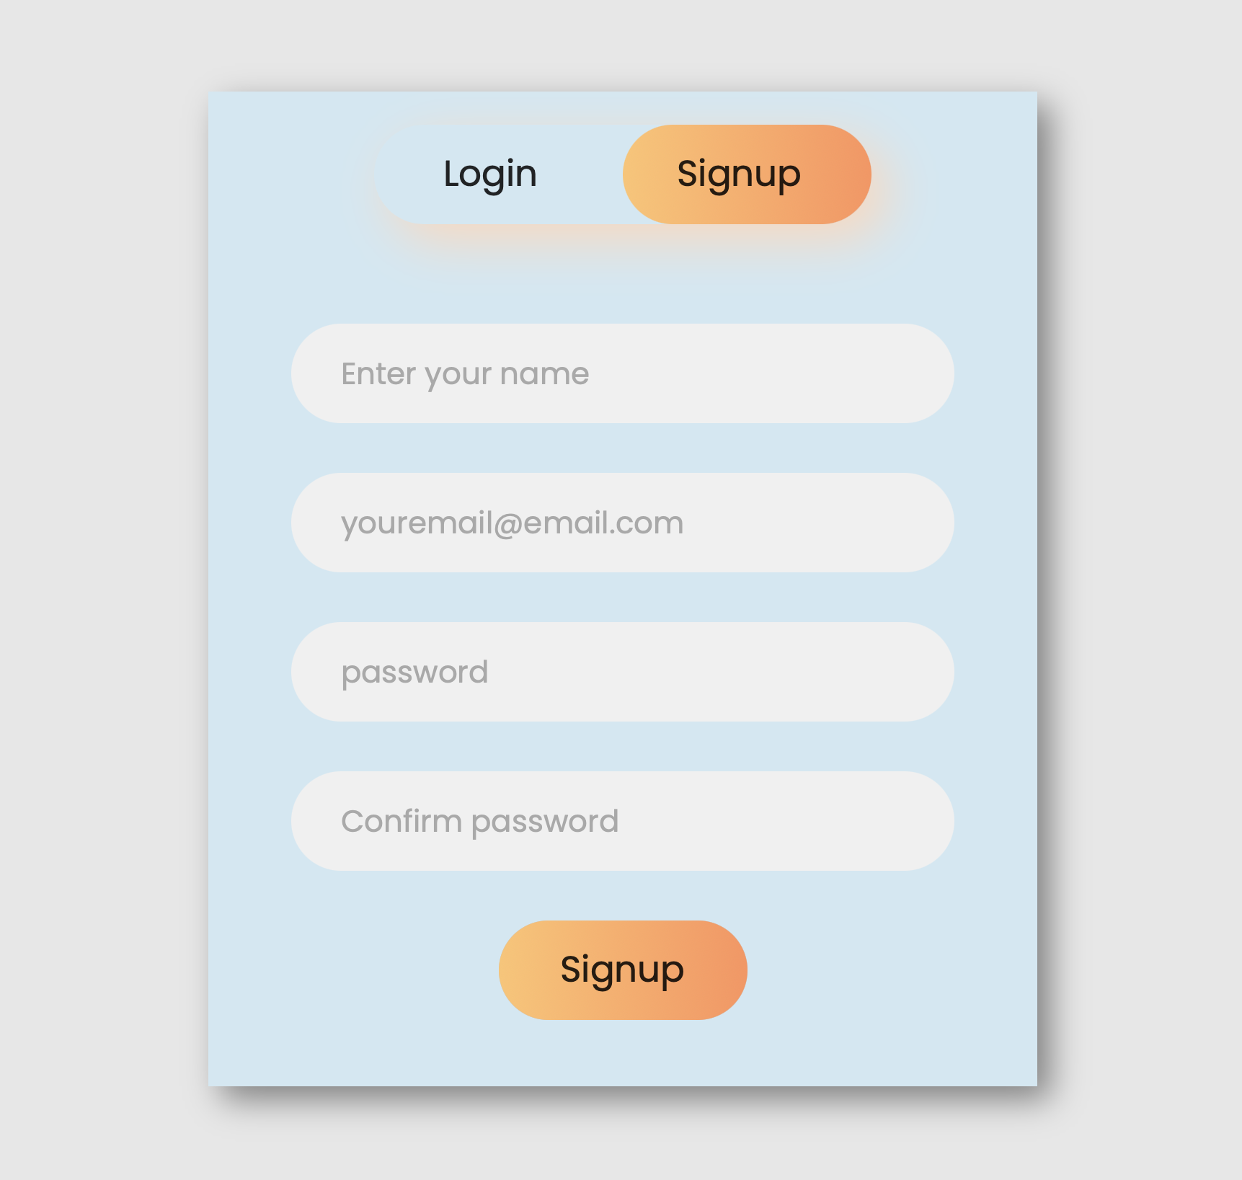
User Sign Up Page

Slide 8
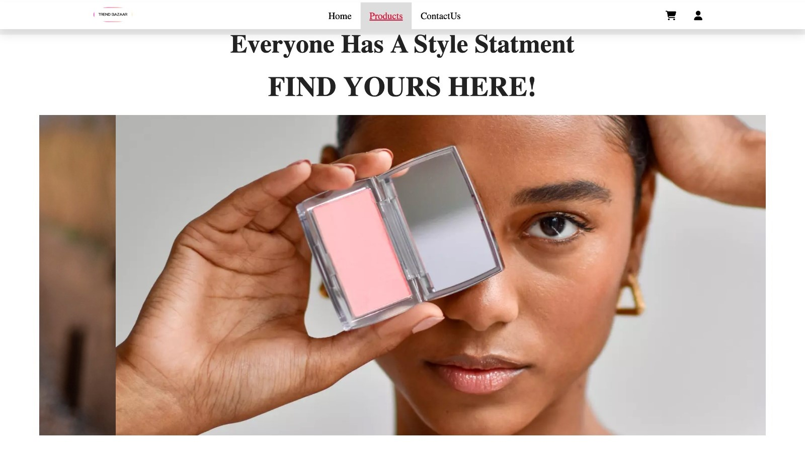
Products Details

Slide 9
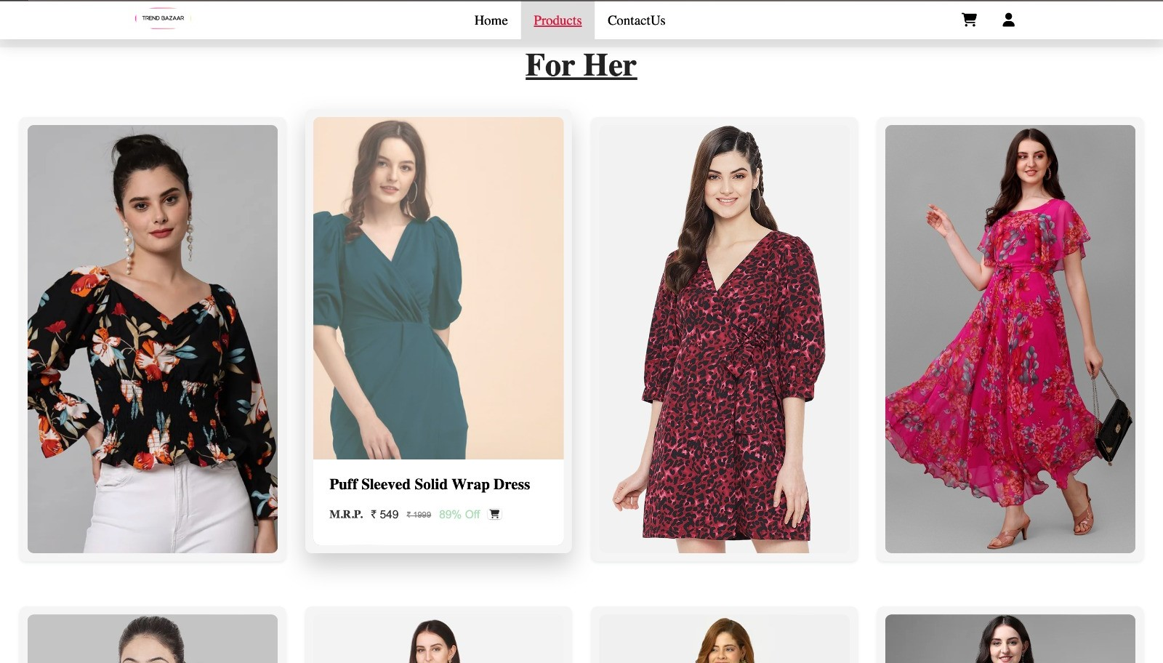
Products Details

Slide 10
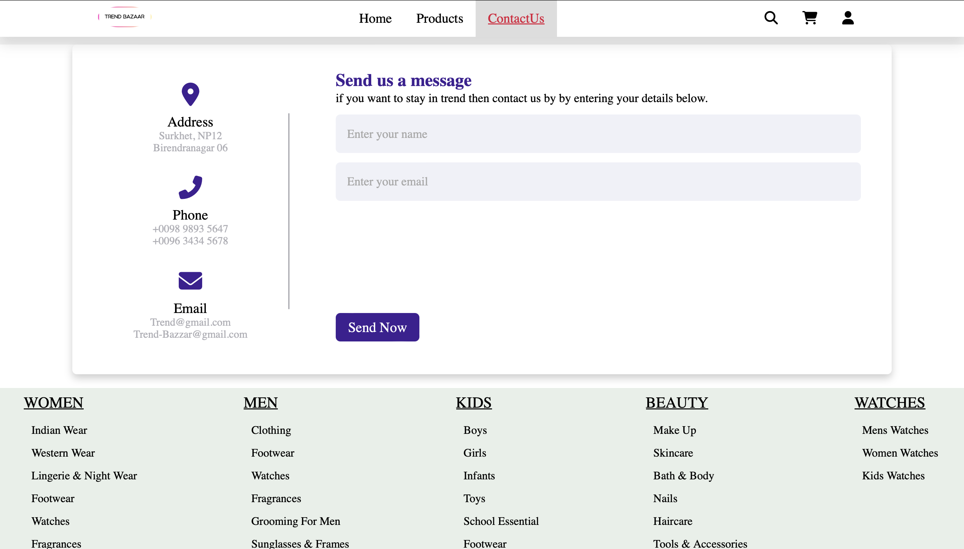
Contact Details

Slide 11
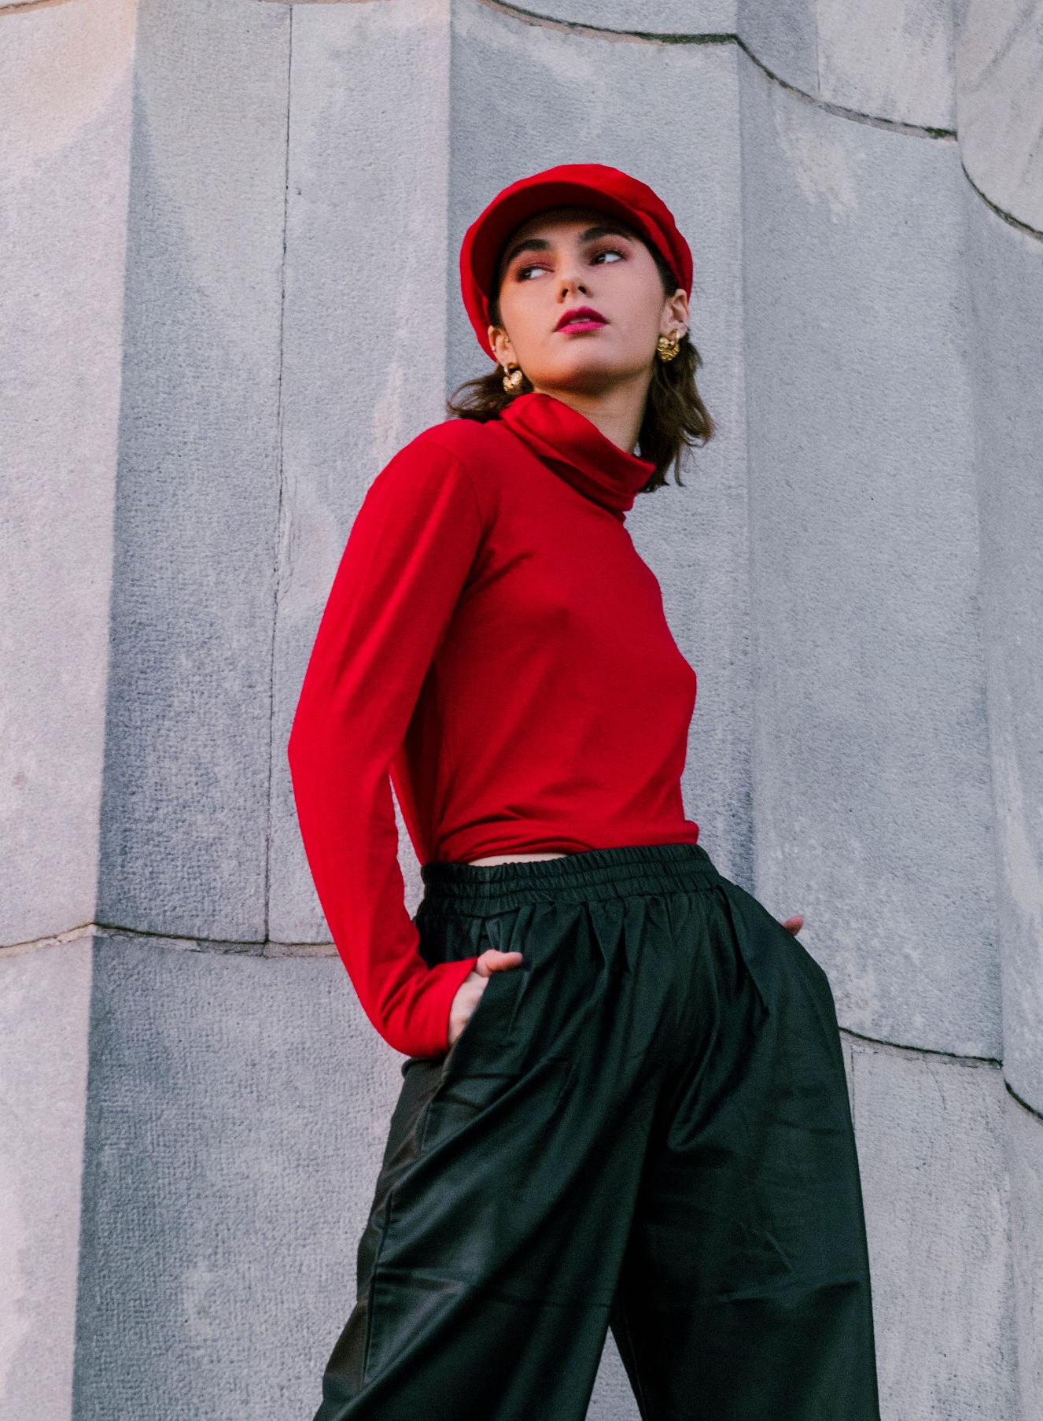
Technology stack
Front-End: HTML5, CSS3, JavaScript.
Back-End: Node.js and Express for server-side logic and API handling.
Database: MongoDB for storing user profiles, product information, and reviews.

Slide 12
User Sign Up Page

Slide 13
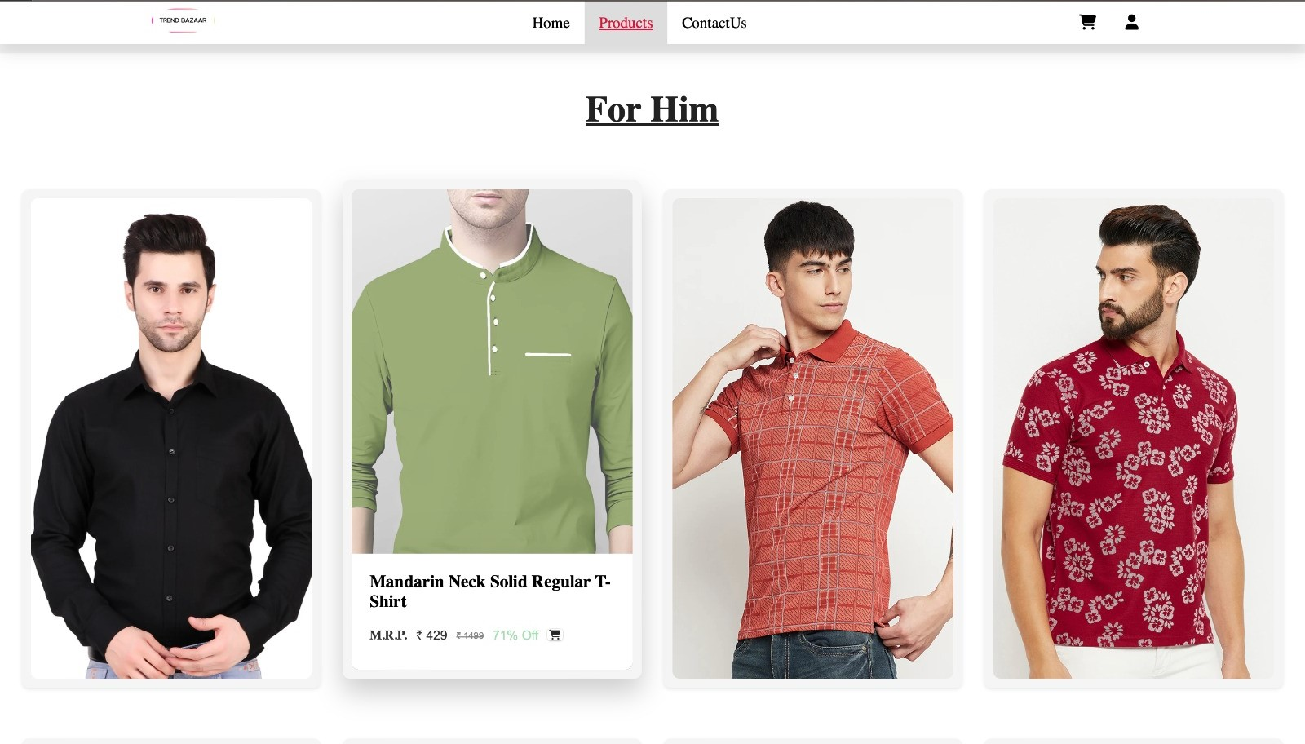
Products Details

Slide 14
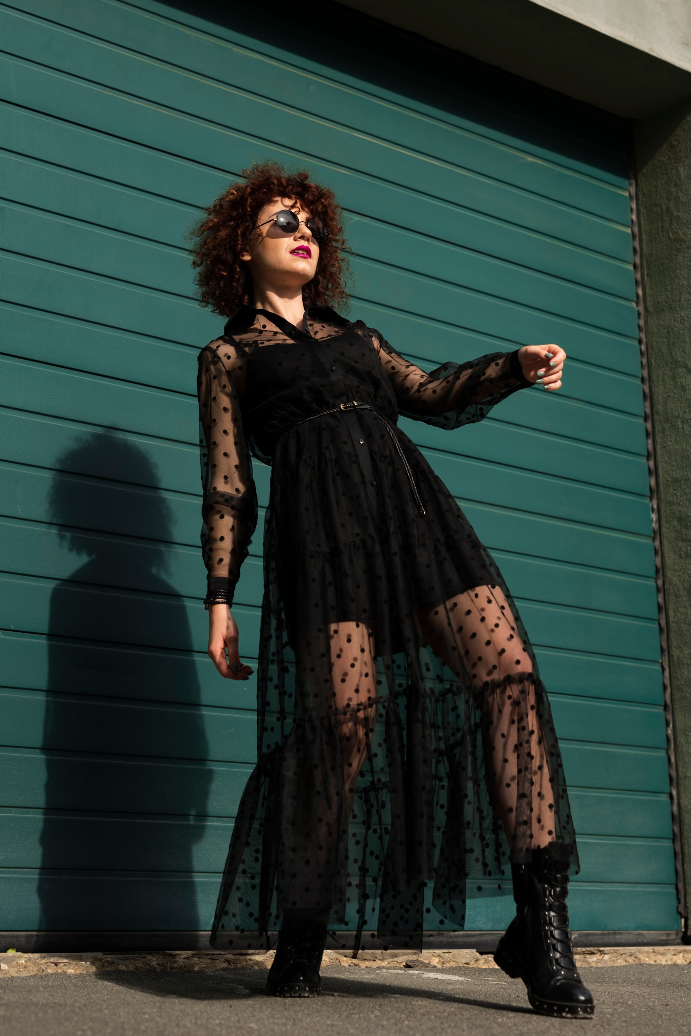
Future Enhancements
Mobile App: Extend the shopping experience to mobile devices for on-the-go convenience.
AI Refinement: Continuously improve the recommendation system for more accurate suggestions.
Global Shipping: Expand shipping options to reach a broader international audience.

Slide 15
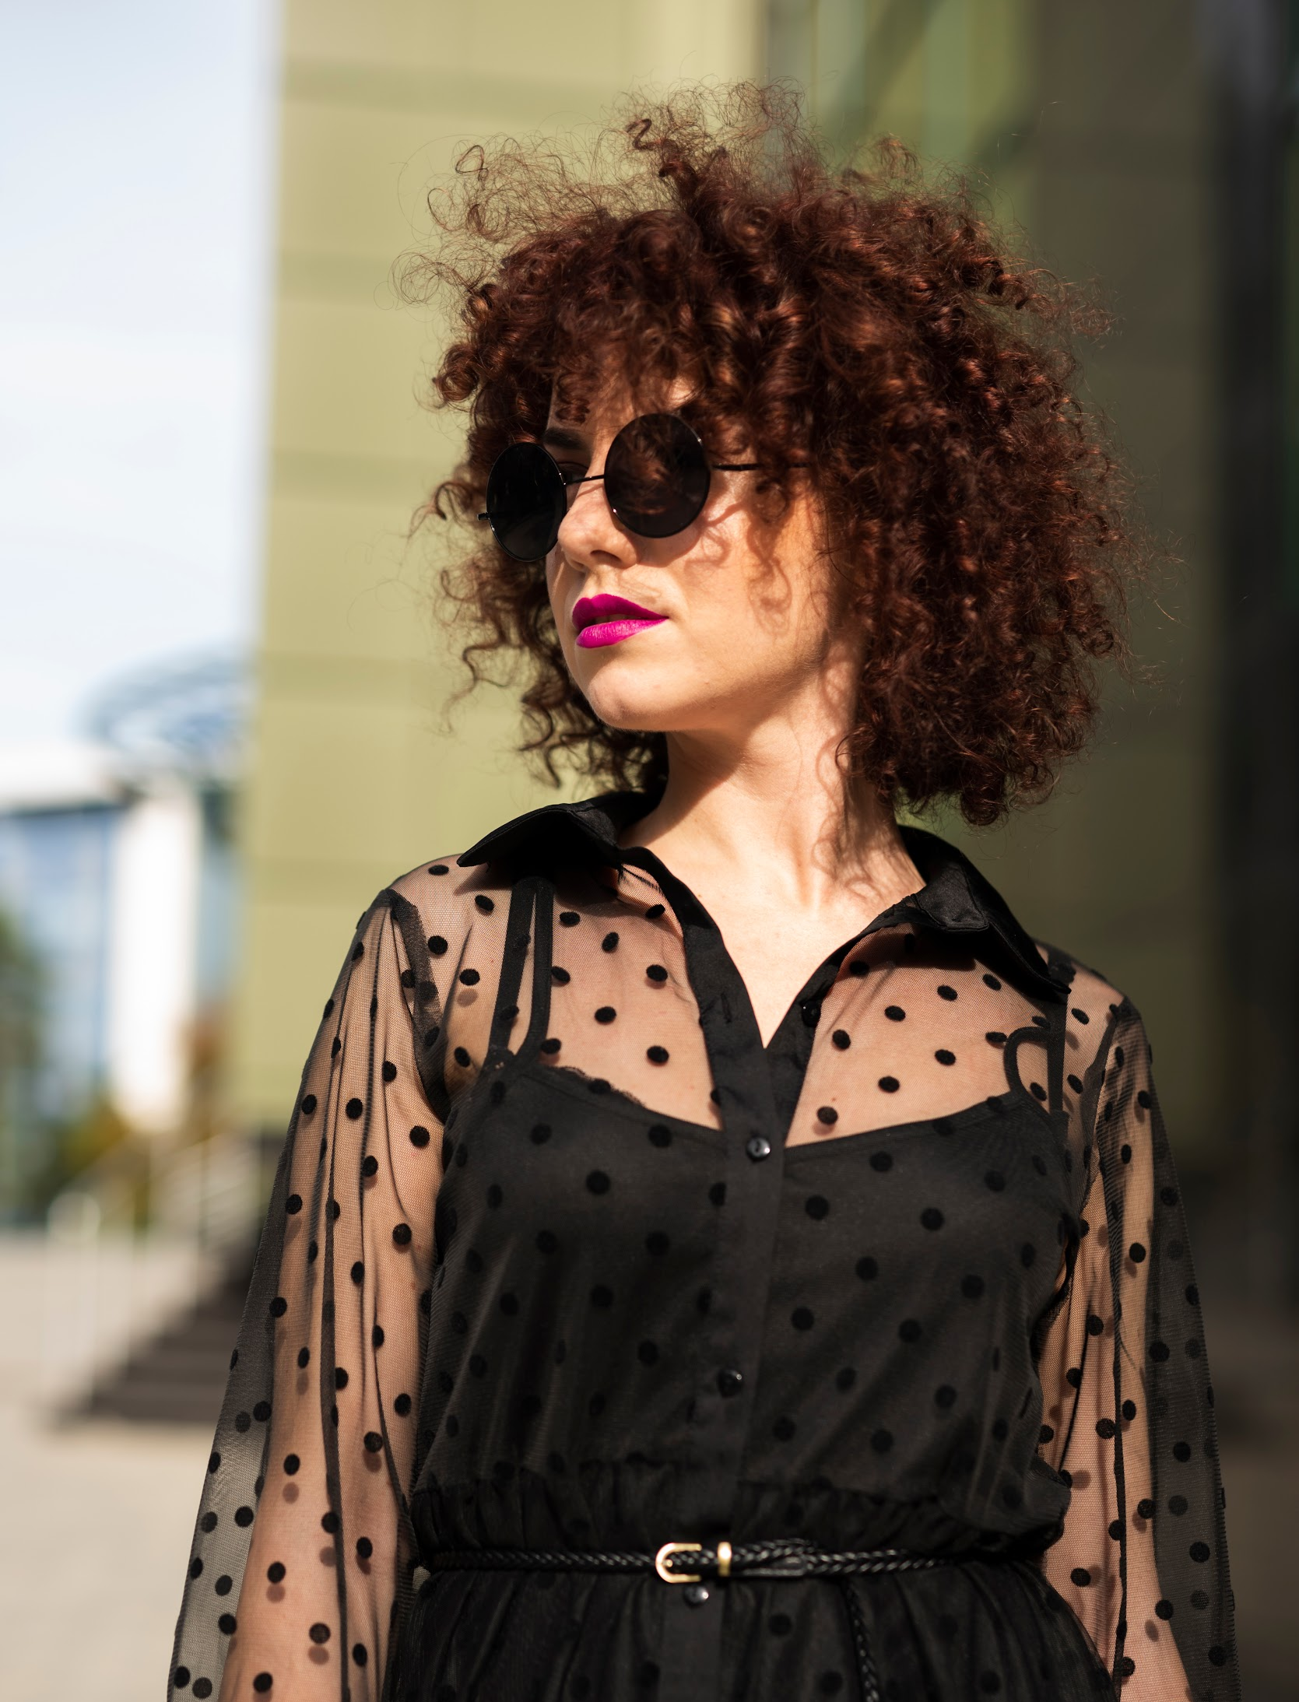
Conclusions
In conclusion, the Trend Bazaar Website stands as a beacon of innovation in the realm of fashion shopping. By seamlessly blending technology with style, it offers users personalized, convenient, and trendsetting experiences. With its virtual try-on, AI recommendations, and global accessibility, it redefines how we interact with fashion. As we move forward, the Trend Bazaar Website remains committed to enhancing the way we shop, inviting you to be part of this transformative journey into the future of fashion.

Slide 16

Thank you

